Slide 1



USED VEHICLE PRICE PREDICTION
Sanjay Jaras, Satish Agrawal
Bellevue University
DSC-630

Slide 2
Introduction and problem statement
Price of a used vehicle is very important and needs to be consistent and fair.
There are variety of factors that impact the price of a user vehicle.
This project uses a dataset with various features about the vehicles listed and sold in the past and attempts to predict a price for new listing.
This will be useful in coming up with a fair price of the used vehicle keeping the margin and market in mind.

Slide 3
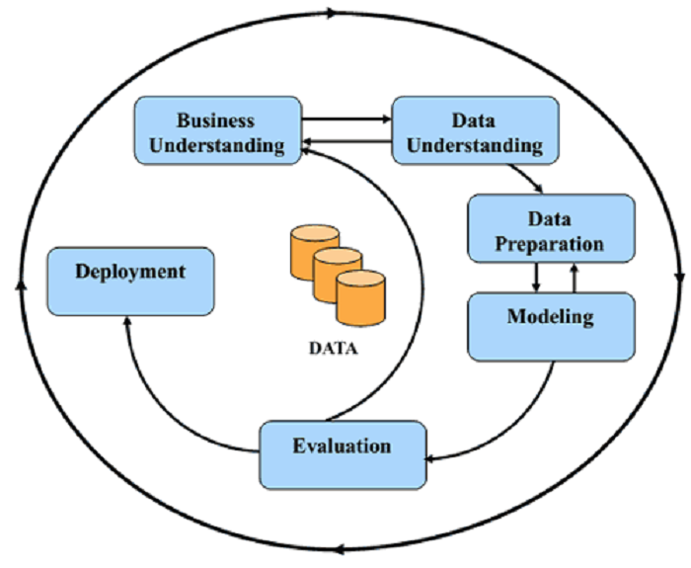
MAJOR STEPS
Data understanding
Split the data set into train and test set
Exploratory analysis of the data set
Data cleaning and preparation
Feature selection and engineering
Exhaustive model training
Model evaluation and selection
Testing with test data
Discuss the best model and Model deployment

Slide 4
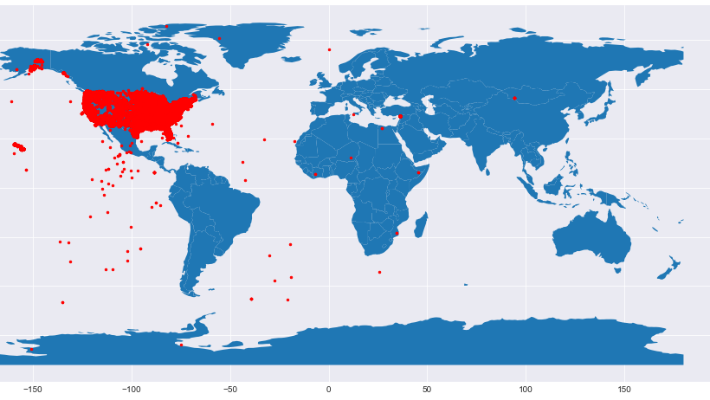
The dataset used in this analysis is from Craigslist and has more than 458K observations of used vehicles listings;.
There are 25 attributes in the data set for each listing
The price for the vehicle is in the dataset and is our target variable that we are trying to predict using machine learning models
Key attributes are odometer, make and model, yea, fuel type and transmission
Dataset

Slide 5
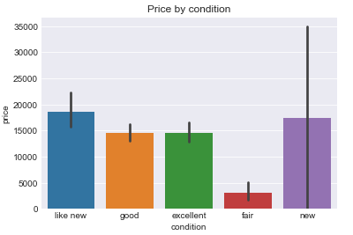
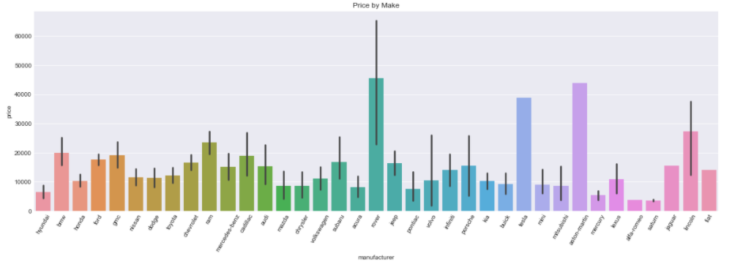
We performed EDA on most of the attributes to understand the distribution and find any correlations with target variable.
The two figures here show the distribution of the odometer reading and the vehicles make year.
This information helps understand that the data is uniformly distributed and is representative of the real-world scenario
EXPLORATORY DATA ANALYSIS

Slide 6
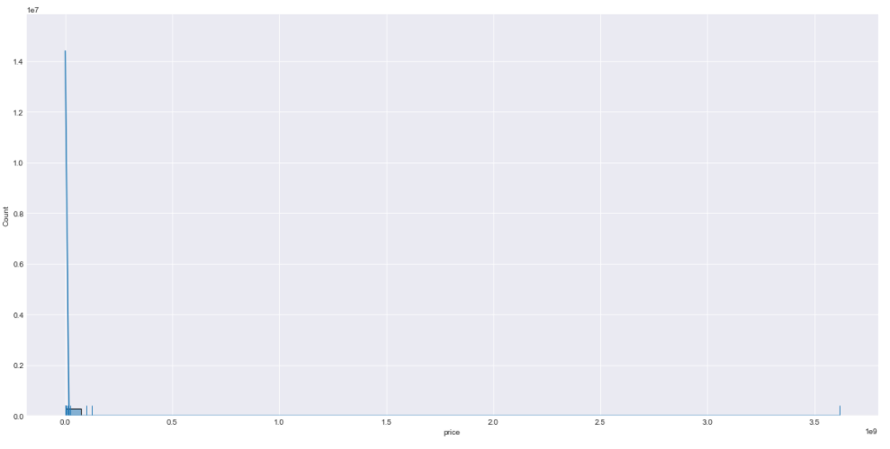
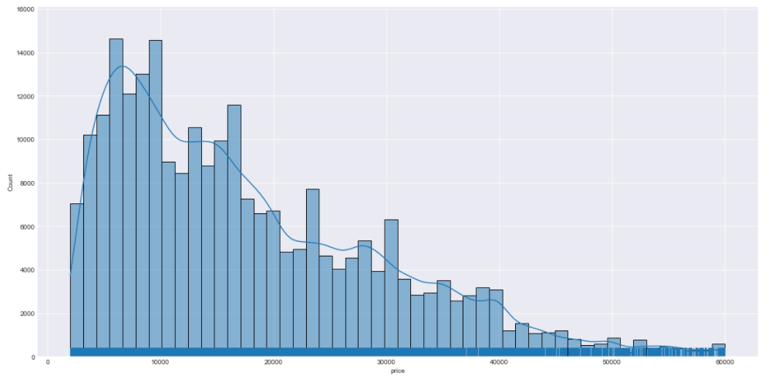
Data cleaning and preparation
We removed the outliers from price and odometer
Above graphs show the distribution before and after outlier removal
We imputed missing values with the most frequent value
We also removed the feature “size” because it has more than 50% missing values and may not be as helpful in price prediction

Slide 7
Feature selection and engineering
We removed URL, ID, Image_URL, Description, Region_URL and VIN from the dataset.
These features do not have any correlation with the price of the car and may not contribute in making price prediction
We used model year and listing date to derive the age of the car at the time of listing. Age has an important role to play in price prediction.

Slide 8
Training models
Training is the process of applying available data to the chosen algorithm(s).
We chose to train Linear regressor, DecisionTreeRegressor, XGBRegressor and RandomForestRegressor models.
Training multiple models allows comparing and choosing the best performing model.
We employed exhaustive search technique to train multiple models for the same algorithm and tune the hyperparameters to come up with the best model for the best hyperparameters.
We ended up training 80 models in total.

Slide 9
Model selection and scoring metrics
Model selection is the process of selecting the best performing model with the best hyperparameters
Scoring metrics allow comparing assorted models.
There are many scoring metrics to choose from including Max error, r-square, explained variance, accuracy, F1 score etc.
We chose accuracy be the scoring metrics for our model evaluation and selection process.
K-fold cross validation splits data into K-folds and uses K-1 flods to train a model and remaining one-fold to validate the performance using the metric provided.
We used 5-fold validation.

Slide 10
MAJOR CHALLENGES AND RESOLUTIONS
Though dataset has around 485k observations, one hot encoding was increasing the number of attributes in the set and was crashing the program.
Dataset has many categorical attributes. Using one-hot encoding was making model overfit.
As we split the dataset before in hand, we saw missing categories in the training dataset which were present in test dataset.
To avoid above issue, we delayed the split of the dataset which was potentially introducing data snooping issues to the project.
We found that sklearn has a newer version 0.24 where this has been handled and it worked fine for us.

Slide 11
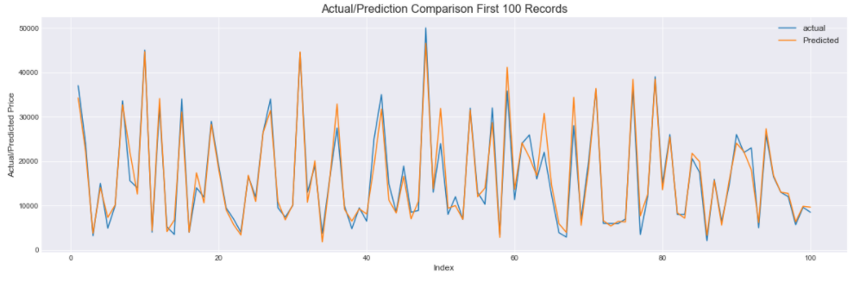
At this point of the analysis, we have achieved 93% of accuracy in used vehicle price prediction.
Graph above shows predictions are accurate or close to the actual price for the car.
We are planning to work towards using PCA for selecting best correlated attributes to achieve better performance.
We are exploring options to use Model ensembles to gain better accuracy.
If we have other features like improvements to the vehicle or accessories added, would help improvise the prediction.
Outcome and next steps

